Slide 1
Introduction to Git
Introduction to Git
Dr. Igor Steinmacher
e-mail: igorfs@utfpr.edu.br
Twitter: @igorsteinmacher

Slide 2
But, Before
Groups
Short Talks
Essays
Assignments

Slide 3
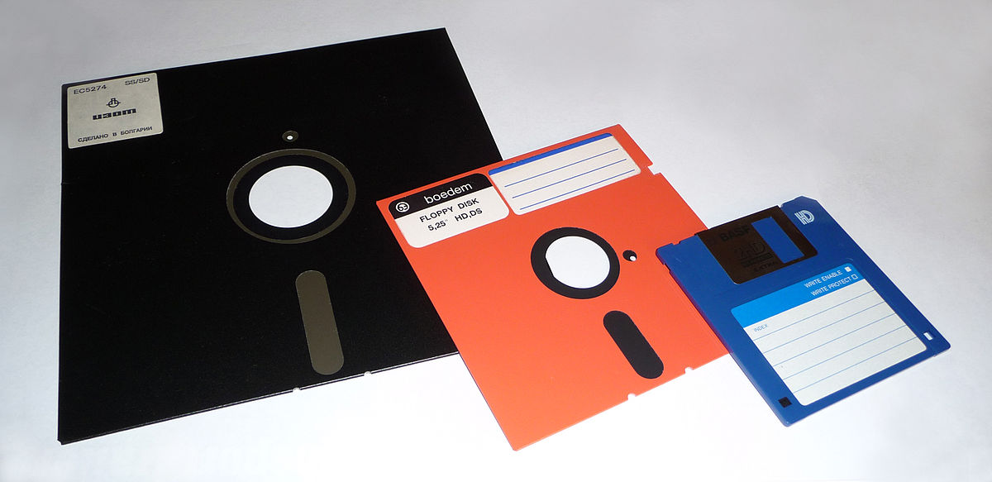
Code Management/Versioning
Team development
Code sharing and versioning…

Slide 4
Code Management/Versioning

Slide 5
We will focus on:

Slide 6







Who offers this service
Your machine! (?)

Slide 7
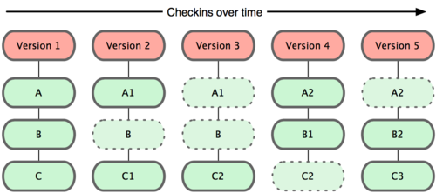
How Git Manages Files Over Time

Slide 8
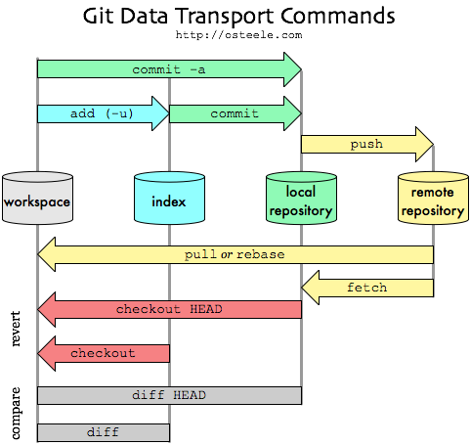
Git - Overall

Slide 9
In-Person Protocol
You will receive an email informing you about your group
Telling the day you can come in-person
You CANNOT come in-person any other day
You MUST wear mask in the classroom (the whole time)
You MUST keep social distance
PLEASE, bring laptop, tablet, so you can use ZOOM
If you are assigned to come, and decide to attend online, LET ME KNOW

Slide 10
Git Local Flow - Example
F3
F4*
F1
F2
F4
F4+
Commit
Branch
Merge

Slide 11
Git Local Flow - Example
Server
Init
F1
F2
F4
Class 2
Clone
Push
Pull
Init
F1
F2
F4
Class 2
PC

Slide 12
It’s Hands On Time
2 Moments
Moment 1:
Local commands: add, commit, branch, merge, conflicts..
Moment 2
Interaction with the remote repo: Push, pull

Slide 13
Kicking off
git config --global user.name “Igor Steinmacher”
git config --global user.email “igor.Steinmacher@nau.edu”
Create a folder / access this folder
git init
This folder is a repo
For all repos

Slide 14
Hands On
Create a file
Check the status of the repo
git status
Add the file to the index
git add <filename>
Check the status

Slide 15
Hands On
Our first commit
git -a -m “Our first commit!!!”
-a → all files
-m → will include a commit message
Check the last commits
git log
Check what has been done in the last commit
git show

Slide 16
Hands On
Let’s!
Change the file
git status
git commit …
git status
git log
And this is the basic flow to put your contributions back to the repo
add
commit
status
log
show

Slide 17
Let’s Branch it out!
Listing your branches
git branch
Create a branch
git branch <NEW_BRANCH>
Use another branch
git checkout <BRANCH_NAME>
Latest two in one command
git checkout –b <NEW_BRANCH>

Slide 18
Working in a new Branch
git checkout -b branchNew
<Change one existing file here>
“Hi, my name is Hugh.”
git commit -a -m “Introducing myself”
<Check the content of the file>
git checkout master
<Check the content of the file>
What?!?!

Slide 19
Updating the Master Branch
Usually we branch out for versions, features, bug fixes…
Later on merging back to master
How to merge our recently changed file, then?
In the master branch:
git merge <other_branch>
If everything goes smooth… sweet

Slide 20
Dealing With Small Conflicts
Imagine if you change a file in your branch, and someone else changed the same file
CONFLICT!!!!
Can we still merge it?!?!?
Let’s see:
Change branch
Change file
Commit
Back to master
Change the same file
Commit
MERGE!
Auto-merging <file>
CONFLICT (content): Merge conflict in <file>
Automatic merge failed; fix conflicts and then commit the result.

Slide 21
Usually… For the Easy ones
Here comes common text before
the area where the conflict happens
and bla bla bla
<<<<<<< HEAD
This is what was in the
master branch
=======
And this…
was in the other branch
>>>>>>> other branch
More text that was common,
and no conflict happened here

Slide 22
Exercising it out
Make a new branch called bugfix
Checkout the bugfix branch with git checkout bugfix
Create/change a file and commit
Go back to master with git checkout
Change/create a file (different from the previous one) and commit again
Merge the branch bugfix into master with git merge

Slide 23
Rebasing it all!!!
Another way of combining branches
We can take a set of commits, and copy them in another branch
Master and our branch are not sync’ed
Commit made in master
Commit made in the branch
From the branch, we can
git rebase master
Now the index of the master is “outdated” → HEAD is pointing to bugfix last commit
git log --graph --all

Slide 24
Moving From Here to There
HEAD is the pointer name for the last checked out commit
We can “detach” the head by “checking out” a specific commit
git checkout <commit SHA>
This is not “safe”
git checkout <branch>
To get back
Moving in the commit tree
Moving one commit at a time with ^
git checkout HEAD^
git checkout master^
Moving a number of times with ~<num>
git checkout master~3

Slide 25
Moving From Here to There
We can move a branch!
git branch -f <BRANCH> HEAD~3
We can also revert changes
git reset HEAD~2
Move the current branch to HEAD - 2 commits position
Works LOCAL
git reflog → see previous commits
git reset <SHA> → SHA of the commit before the reset for “unresetting”
git revert HEAD → To reverse changes to send upstream

Slide 26
Cherry-Picking
Use when you don’t want to copy ALL commits from a branch to another
We can cherry pick those that are of interest
git cherry-pick <SHA1> <SHA2> <SHA3>

Slide 27
Dealing with the Remote Repo

Slide 28
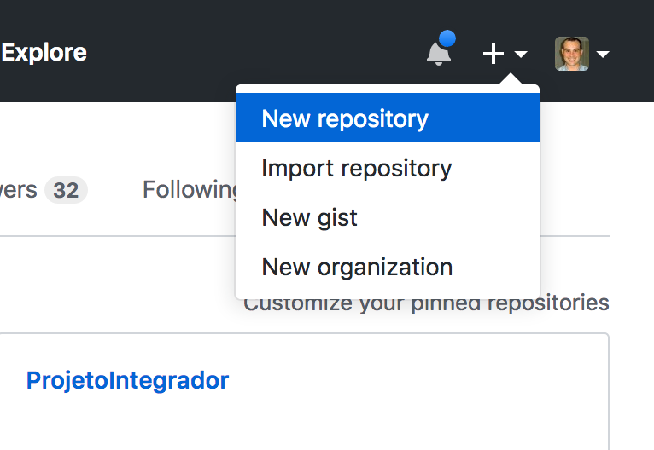
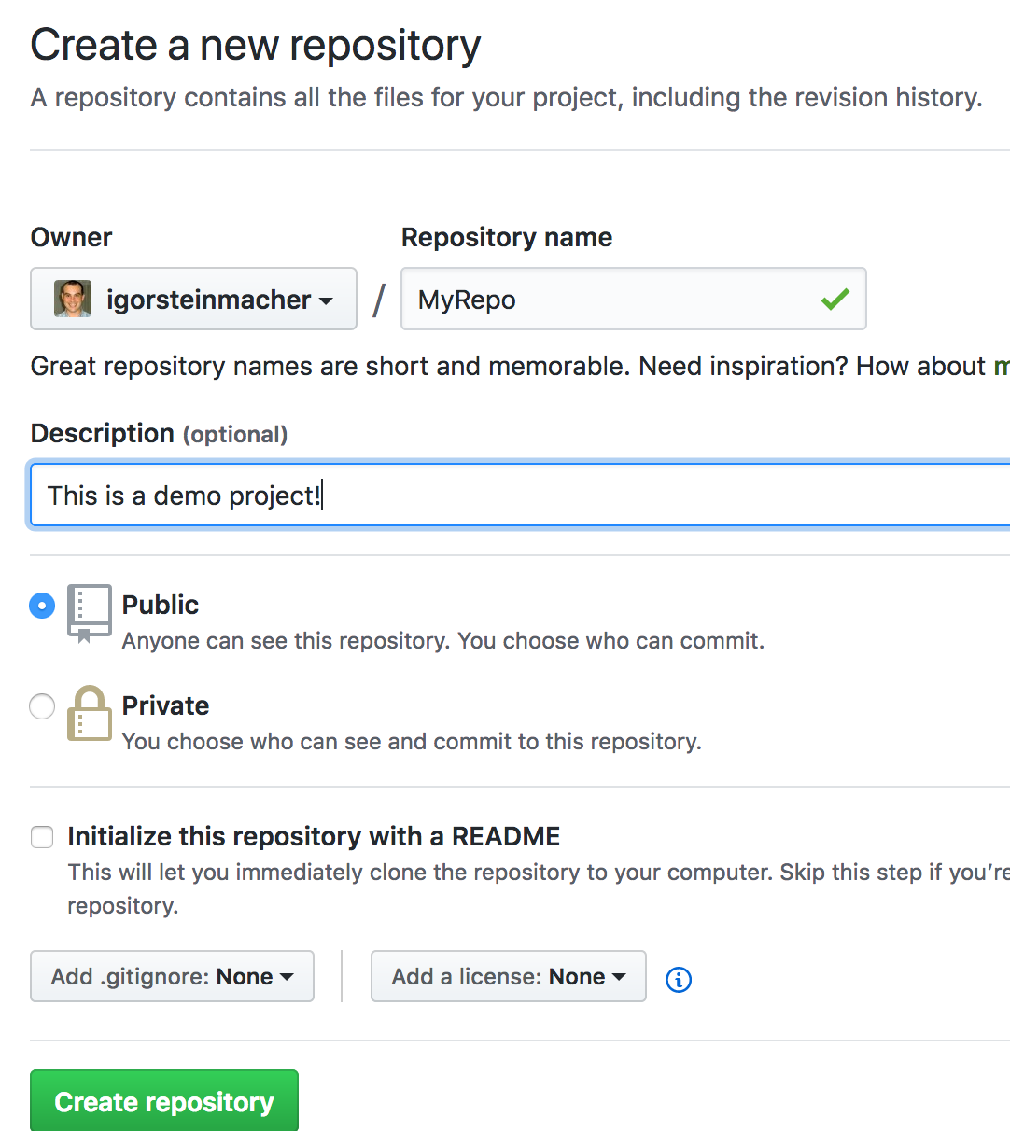
Create a Repo in GitHub

Slide 29
Cloning To a Local Repo
That’s simple! Cloning means bringing all the history to a local repo
git clone https://github.com/<owner>/<repo>
Testing it out
git clone https://github.com/NAU-OSS/githandson.git
Cloning into 'githandson'...
warning: You appear to have cloned an empty repository.

Slide 30
Working In This Repo
Some different commands to deal with remote repo
git branch –r
git pull //pulls everything from the remote repo and updates the local repo
git fetch //pulls changes from remote repos, but it doesn't integrate any of this new data into your working files
git push
git push <remoteName> <branchName> //push your local changes to an online repository (git push origin master)
git push <remoteName> <localBranchName>:<remoteBranchName> // This pushes the LOCALBRANCHNAME to your REMOTENAME, but it is renamed to REMOTEBRANCHNAME.

Slide 31
Usual Workflow
git clone
branch out to add your changes locally
your adds/commits
pull changes to your local repo
merge your branch back (LOCALLY)
Resolve any conflict
push changes back to the remote repo

Slide 32
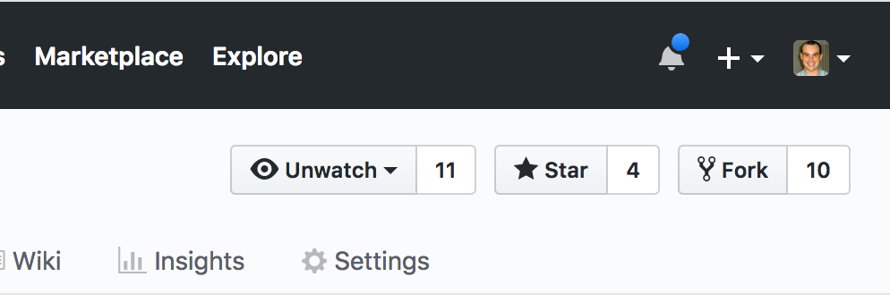
GitHub Workflow
Fork + pull-request
You usually creates a fork for your repo
“A fork is a copy of a repository. Forking a repository allows you to freely experiment with changes without affecting the original project”
Creating a fork
Then, you usually clone your fork… work, and send a pull request against the main repo

Slide 33
Example
Server
master
git pull
#updates local repo
Pull
origin/master
PC
master
master is a local branch
origin/master is a remote branch (a local copy of the branch named "master" on the remote named "origin")
origin is a remote

Slide 34
Example
Server
master
Someone changed
the remote
origin/master
F2
PC
master

Slide 35
Example
Server
master
Me too
git commit -a
Pull
origin/master
PC
master

Slide 36

Example
Push
Server
master
git push #to update remote
Push
origin/master
Local is outdated
PC
master

Slide 37
Example
Solution 1:
Fetch +
Rebase +
Push
Server
master
Push
origin/master
PC
master

Slide 38
Example
Solution 1:
Fetch +
Rebase +
Push
Server
master
origin/master
git fetch
#download remote changes
Fetch
PC
master

Slide 39
Example
Solution 1:
Fetch +
Rebase +
Push
Server
master
origin/master
master
git rebase origin/master
PC

Slide 40
Example
Solution 1:
Fetch +
Rebase +
Push
Server
master
origin/master
Push
master
git push
#pushes changes to remote
PC

Slide 41
Example
Solution 2:
Pull +
Push
Server
master
Push
origin/master
PC
master

Slide 42
Example
Solution 2:
Pull +
Push
Server
master
Pull
origin/master
PC
master
git pull
#download remote changes
and update local

Slide 43
Example
Server
Solution 2:
Pull +
Push
master
Push
origin/master
PC
master
git push
#pushes changes back

Slide 44
A Pull Request Example
(GitHub) Fork
(CLI) Clone (the fork)
(CLI) Commits
(CLI) Push
(GitHub) Send Pull Request
Follow it
Revise it
Update it
Keep your fork up-to-date
https://help.github.com/articles/syncing-a-fork/

